Slide 1

Exploratory Data Analysis
Insight for Bank Marketing Campaign Data
12/8/22

Slide 2
Agenda
Executive Summary
Problem Statement
Approach
EDA
EDA Summary
Recommendations

Slide 3
Executive Summary
Client:
ABC Bank wants to use ML model to shortlist customer whose chances of buying the product is more so that their marketing channel (telemarketing, SMS/email marketing etc) can focus only on those customers whose chances of buying the product is more.
Objective:
Use Machine Learning to shortlist customer whose chances of buying the product is more so that their marketing channel (telemarketing, SMS/email marketing etc) can focus only to those customers whose chances of buying the product is more. This will save resource and their time (which is directly involved in the cost ( resource billing)).

Slide 4
Problem Statement
ABC Bank wants to sell it's term deposit product to customers and before launching the product they want to develop a model which help them in understanding whether a particular customer will buy their product or not (based on customer's past interaction with bank or other Financial Institution).

Slide 5
Problem Statement
Bank wants to use ML model to shortlist customer whose chances of buying the product is more so that their marketing channel (tele marketing, SMS/email marketing etc) can focus only to those customers whose chances of buying the product is more.
This will save resource and their time ( which is directly involved in the cost ( resource billing)).
Develop model with Duration and without duration feature and report the performance of the model.
Duration feature is not recommended as this will be difficult to explain the result to business and also it will be difficult for business to campaign based on duration.

Slide 6
Approach
The data set given is bank-full.csv
It contains 16 features.
The data had no replications
The data had no missing values.
The data did have many outliers.
Since there were many outliers I considered the log of the numerical data and ways of incorporating the median in some calculations so that outliers do not affect the problem as much.

Slide 7
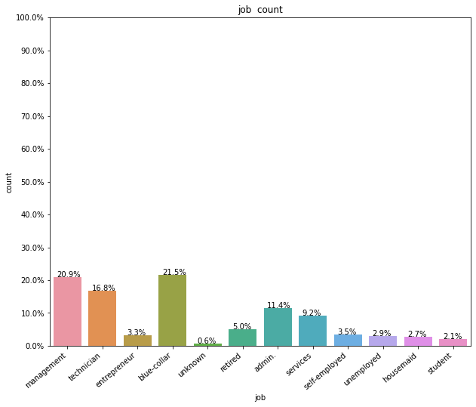
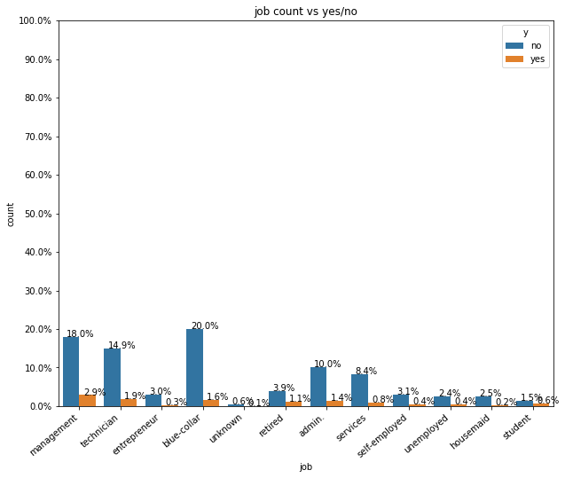
Customers with the job blue-collar were more likely to subscribe

Slide 8
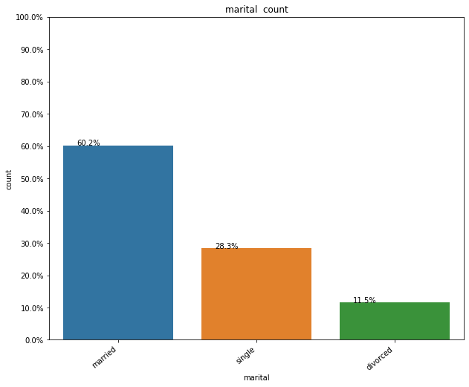
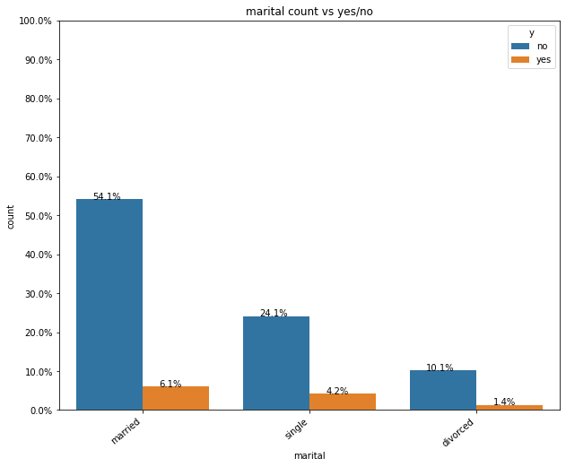
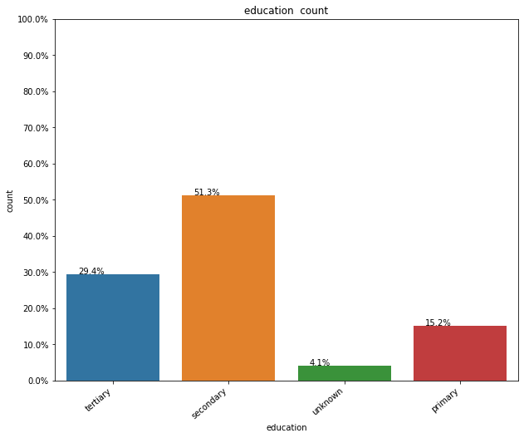
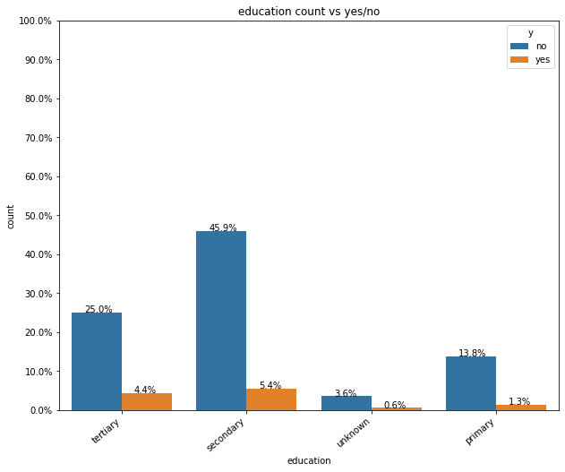
Customers with the marital status "married" are more likely to subscribe and not to subscribe. This is because most customers are married.
Customers with a secondary education are more likely to suscribe and not subscribe. Most customers have a secondary education.

Slide 9
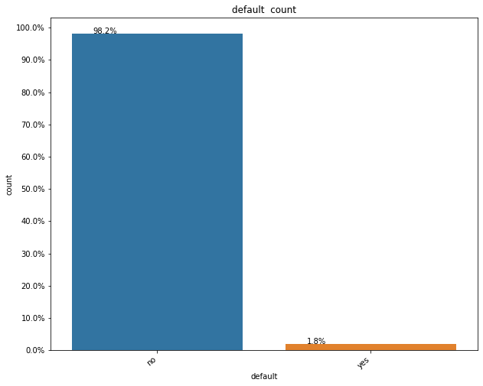
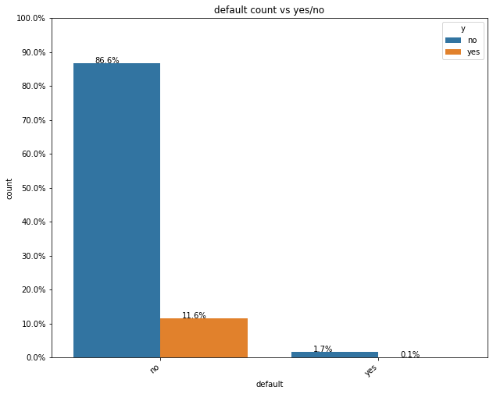
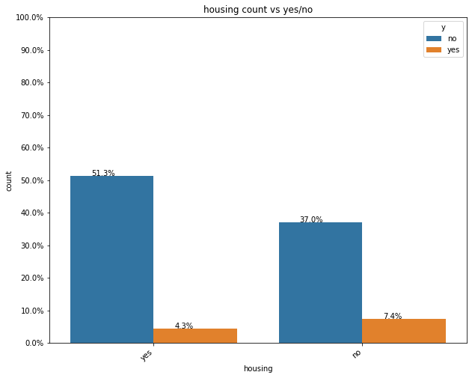
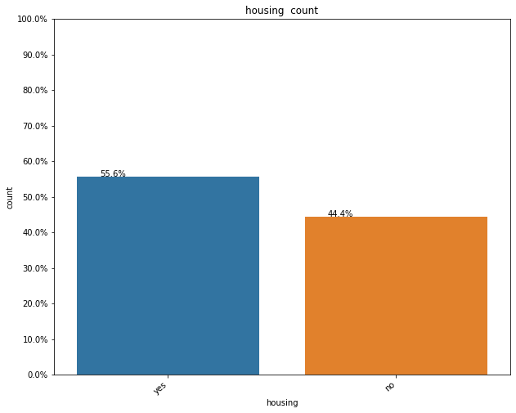
Most customers do not have defaulted credit so they are more likely to subscribe as well as not subscribe. But most of them subscribe.
Those with a housing loan are more likely to subscribe.

Slide 10
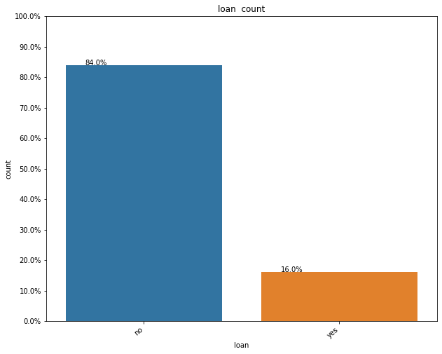
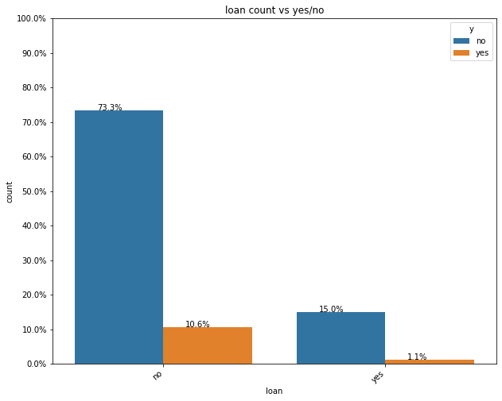
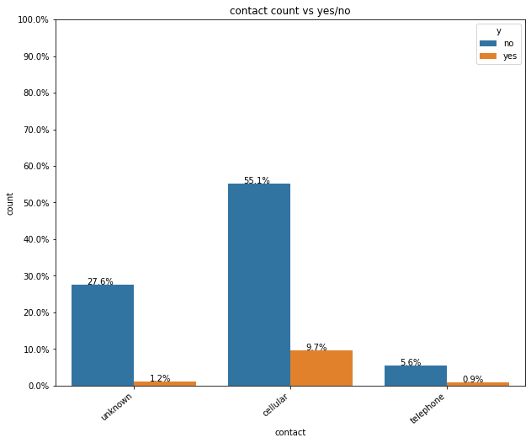
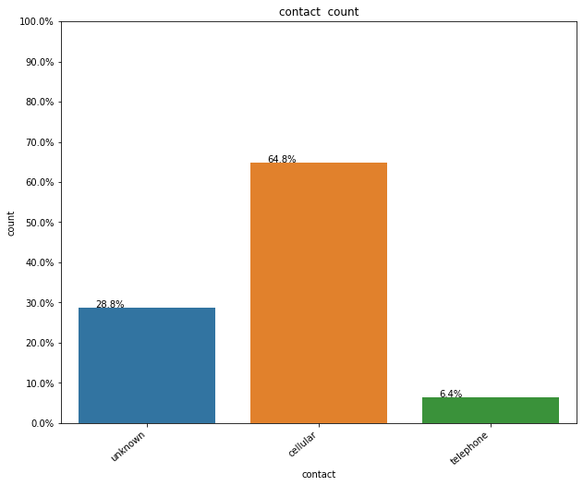
Most customers do not have a personal loan so they are more likely to subscribe if they do not have a personal loan.
Most customers have cell phones.

Slide 11
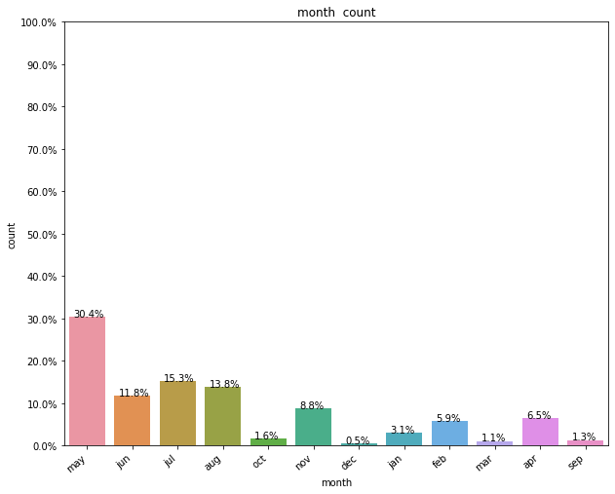
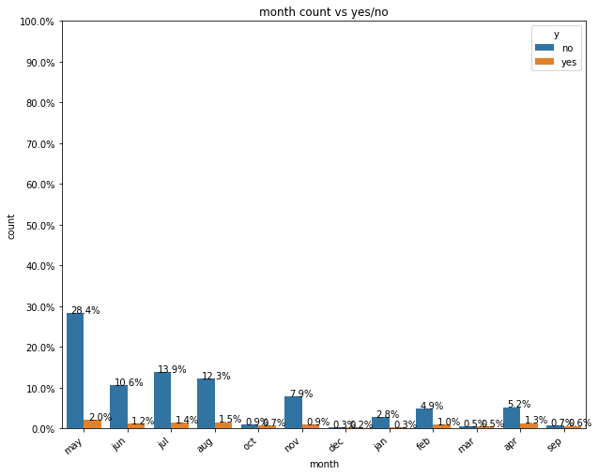
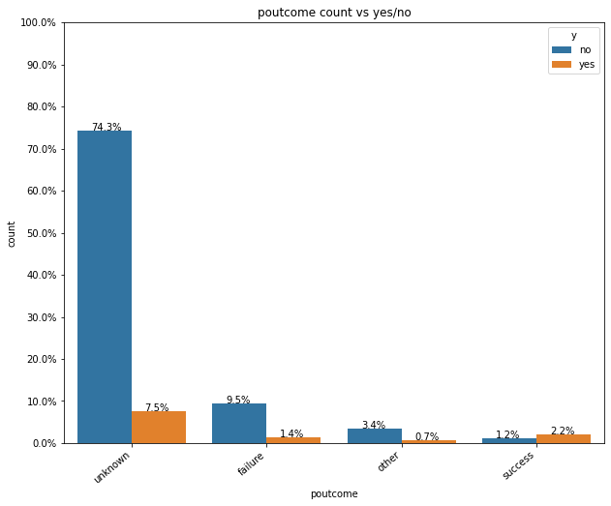
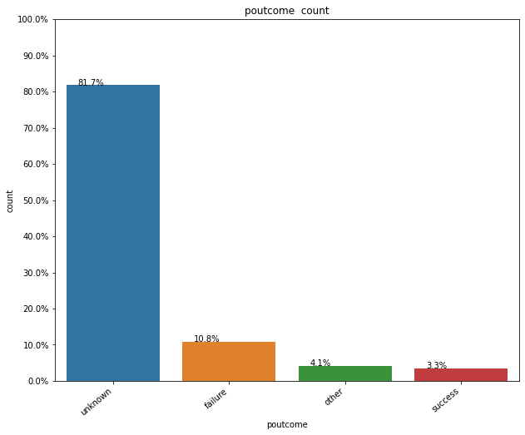
Most customers were contacted last in May.
Most customers have a previous outcome of unknown.

Slide 12
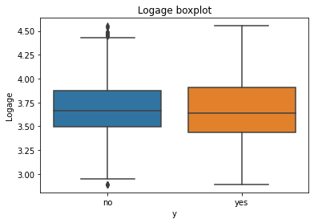
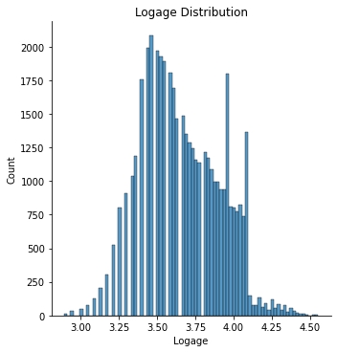
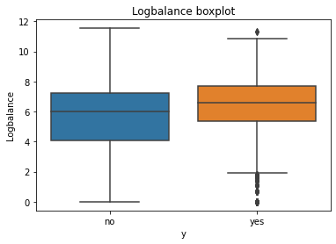
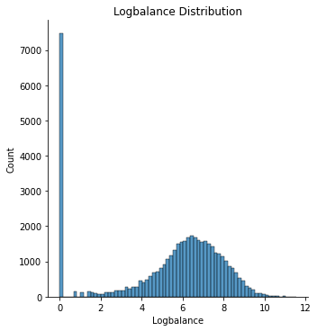
From the boxplot we see the median age of the customer who did and did not subscribe is 37-39. With so much overlap age is not necessarily a good indicator of customers and their subscription choices.
From the distribution we see that most of the customers are between 30-45.
The median for balance is about the same for customers who subscribe as well as those who do not subscribe.
There is a lot of overlap so balance does not seem useful.

Slide 13
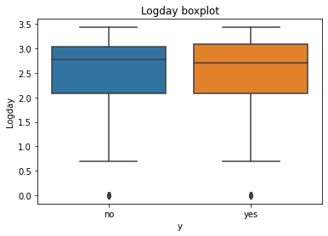
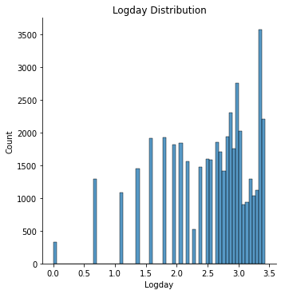
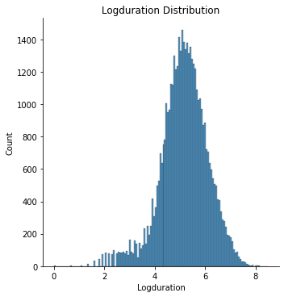
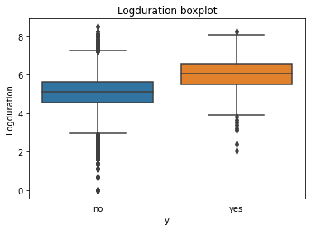
The median for the day customers subscribe or do not subscribe is between 15-16.
The distribution shows the most customers are between days 5 and 20. With so much overlap the day does not seem useful.
The duration has very little overlap so it will be useful in indicating subscription choices

Slide 14
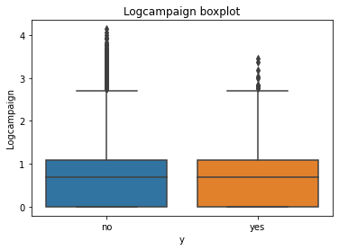
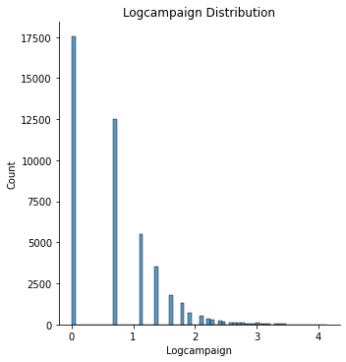
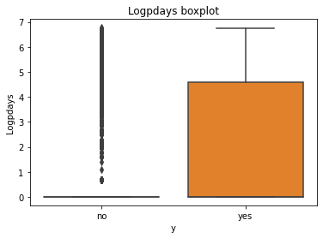
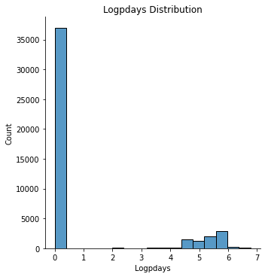
The campaign and pdays has very little overlap so they will be useful in indicating subscription choices

Slide 15
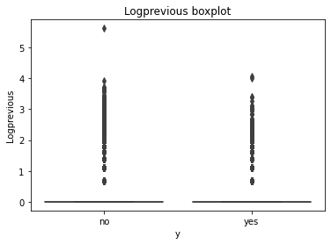
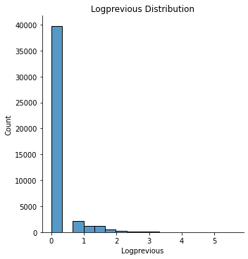
The customers fall between 0-0.25 for previous.

Slide 16
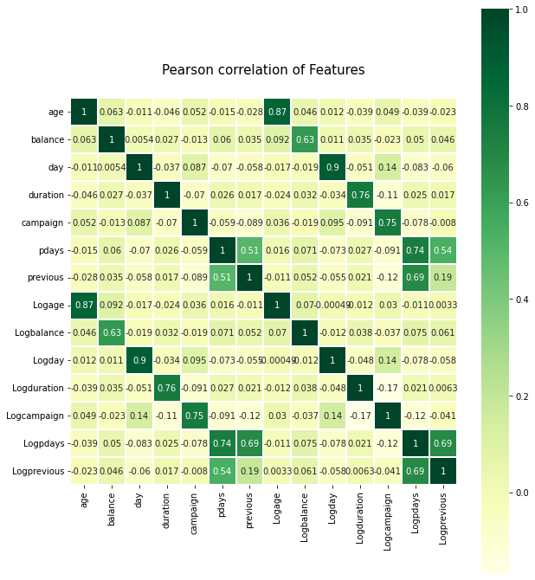
Previous and pdays have the highest correlation. They have a positive correlation of 0.69.

Slide 17
Recommendations
Previous and pdays have the highest correlation.
The campaign and pdays has very little overlap so they will be useful in indicating subscription choices.
The duration has very little overlap so it will be useful in indicating subscription choices.

Slide 18
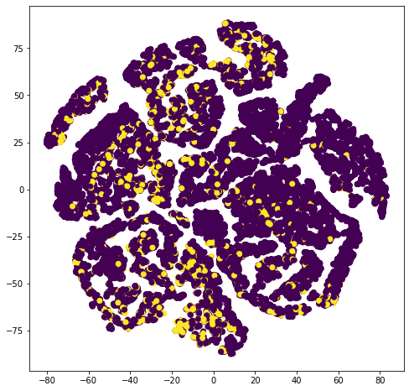
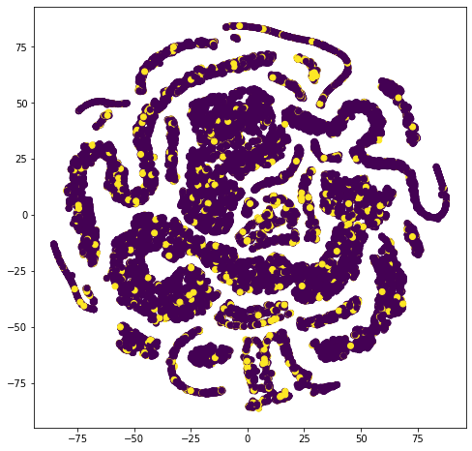
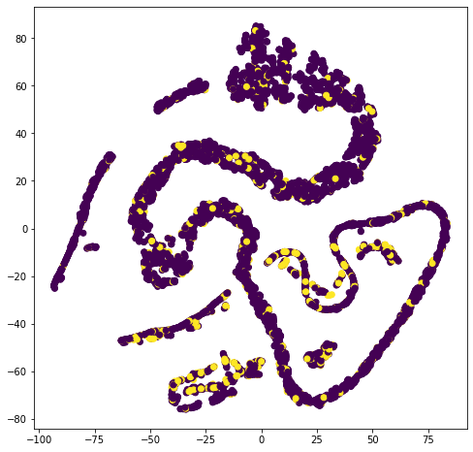
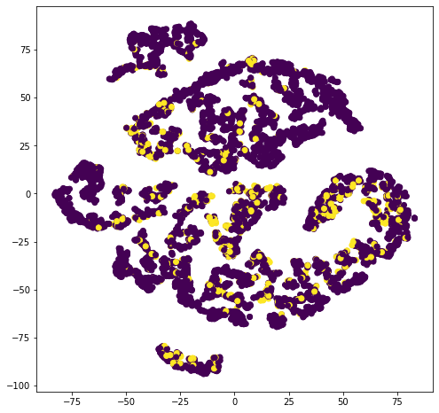
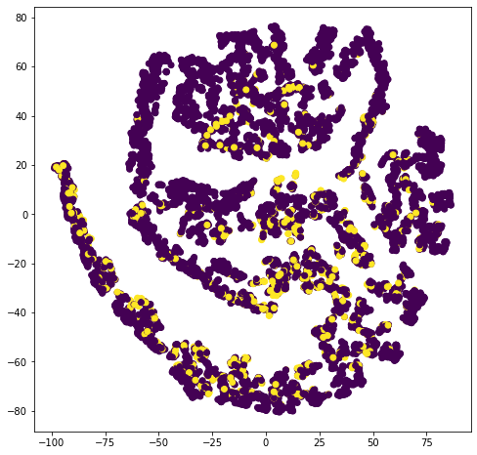
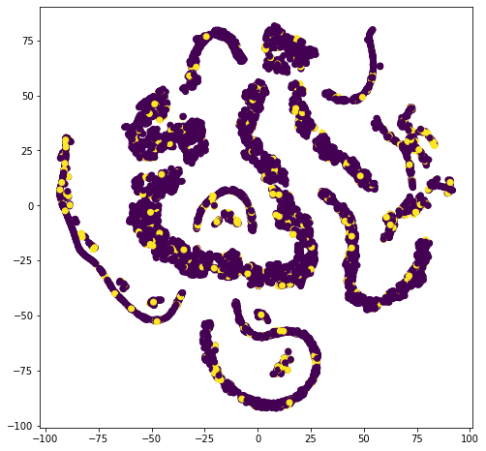
Visualization with Duration
Visualization without Duration

Slide 19
Comparing the Model with and without Duration
The "duration" is highly correlated with the targeted feature so the final model will not include the duration feature with "duration" column.
Next we were able to check the model with a ROC AUC score of 1 without duration and class balancing.
The ROC AUC score was 1 with duration.

Slide 20
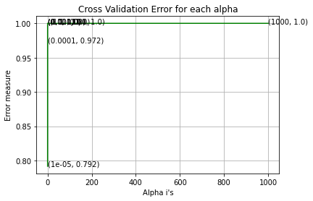
Logistic Regression Results
AUC for k = 1e-05 is 0.791782429371228
AUC for k = 0.0001 is 0.9718790365682718
AUC for k = 0.001 is 0.999960763066678
AUC for k = 0.01 is 0.9999990832492215
AUC for k = 0.1 is 0.9999983498485986
AUC for k = 1 is 1.0
AUC for k = 10 is 0.9998909066573525
AUC for k = 100 is 0.9999889989906574
AUC for k = 1000 is 0.9999697472243079
For values of best alpha = 1 The train AUC is: 1.0
For values of best alpha = 1 The cross validation AUC is: 1.0
For values of best alpha = 1 The test AUC is: 1.0

Slide 21
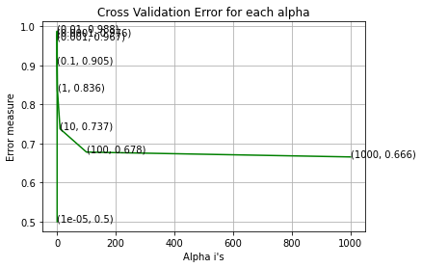
Linear SVM Model
AUC for alpha = 1e-05 is 0.5
AUC for alpha = 0.0001 is 0.9763815663420451
AUC for alpha = 0.001 is 0.9670252078961579
AUC for alpha = 0.01 is 0.9876326652970409
AUC for alpha = 0.1 is 0.9047264919889733
AUC for alpha = 1 is 0.8357076261747015
AUC for alpha = 10 is 0.7374968486691987
AUC for alpha = 100 is 0.6780008232421991
AUC for alpha = 1000 is 0.6656153368738248
For values of best alpha = 0.01 The train AUC is: 0.9763558135102671
For values of best alpha = 0.01 The cross validation AUC is: 0.9772851159093845
For values of best alpha = 0.01 The test AUC is: 0.9774027766682715

Slide 22
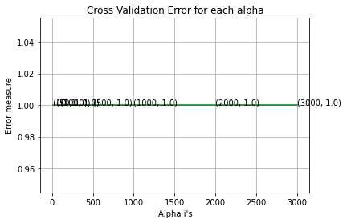
Random Forest Model
AUC for number of estimators = 10 is 1.0
AUC for number of estimators = 50 is 1.0
AUC for number of estimators = 100 is 0.9999999999999999
AUC for number of estimators = 500 is 1.0
AUC for number of estimators = 1000 is 1.0
AUC for number of estimators = 2000 is 1.0
AUC for number of estimators = 3000 is 1.0
For values of best alpha = 10 The train AUC is: 1.0
For values of best alpha = 10 The cross validation AUC is: 1.0
For values of best alpha = 10 The test AUC is: 1.0

Slide 23
Conclusion
We wanted to predict whether a customer will subscribe to a term deposit.
We did EDA on the numerical and categorical data.
After doing data visualization with T-SNE the data shows the two classes are overlapping.
Using one-hot encoding we were able to encode the categorical variables.
After testing various models the Random Forest Model was the most accurate with a test AUC score of 1.0.

